Slide 1
Lecture 11: Serial Data Communication & 8251
Assistant Prof. Hongzi Zhu
hongzi@cs.sjtu.edu.cn

Slide 2
The 80x86 IBM PC and Compatible Computers
Chapter 17
Serial Data Communication and the 8251 Chip

Slide 3
Data Communication
Data transmission is the transfer of data from point-to-point often represented as an electromagnetic signal over a physical communication channel
A communication channel refers to the medium used to convey information from a sender (or transmitter) to a receiver.
  Examples: copper wires, optical fibbers or wireless communication channels.

Slide 4
Two Ways: Parallel & Serial
Parallel data transfers:
  Each bit uses a separate line (wire)
  Often 8 or more lines are used
  Control signals in addition
  Fast & expensive & for short-distance communication
Serial data transfers:
  One single data line
  Bits are sent over the line one by one
  No dedicated lines for control signals
  Cheap & slow & for long-distance communication

Slide 5
The Whole Picture of Serial Communication
The sender and receiver need a protocol to make sense of data:
  e.g., how the data is packed, how many bits constitute a character, when the data begin and end
Computer
Computer
Serial
interface
MODEM
channel
MODEM
Serial
interface
DTE
DCE
DCE
DTE
DTE- Data Terminal Equipment, usually a computer.
DCE- Data Communication Equipment, usually a modem.
Serial interface –ICs such as 8251A,16550, and 8250, connecting DTE and DCE.

Slide 6
Serial Communication
Data transfer rate
Synchronization methods
Communication modes
Error detection
Modulation and Demodulation

Slide 7
Data Transfer Rate
Symbol rate, a misnomer is baud rate
  The number of distinct symbol or pulse changes (signaling events) made to the transmission medium per second in a digitally modulated signal or a line code, quantified using the baud unit
  Each symbol can represent one (binary encoded signal) or several bits of data
Bit rate
  the number of bits that are conveyed or processed per unit of time, quantified using the bits per second (bit/s or bps) unit

Slide 8
Synchronization Methods
Asynchronous serial communication:
  Transfer one byte at a time
  The starting of each byte is asynchronous, and therefore each byte needs synchronization between the sender and the receiver using start bit.
Synchronous serial communication:
  Transfer a block of data at a time
  The sender and the receiver are synchronized at the beginning of data transfer using synch characters.

Slide 9
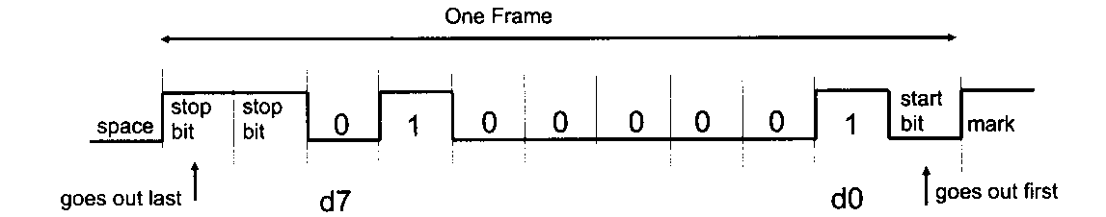
Asynchronous Serial Communication
Framing method:
  Each character is put in between start and stop bits
  Start bit: 0 (low)
  Character: 5, 6, 7, or 8 bits
  End bit(s): 1 (high)

Slide 10
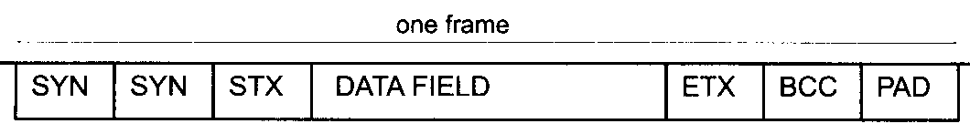
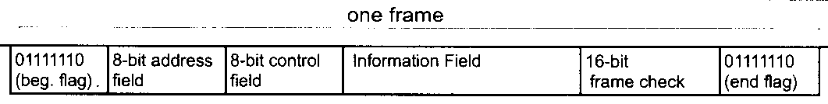
Synchronous Serial Communication
Framing method, in case of the BISYNC protocol
  Synch characters
  STX (start of text) character
  A block of data
  ETX (end of text) character

Slide 11
Communication Modes
Simplex:
  Only one way
  E.g., printer
Half-duplex:
  Data is transmitted one way at a time
  E.g., walky-talky
Full-duplex
  Data can go both ways at the same time
  E.g., telephone

Slide 12

Error Detection
Parity bit
  Used in asynchronous serial communication
  Put an extra parity bit at the end of each character
    Even-parity: the data and the parity bit has an even number of 1s; odd-parity
CRC Calculation
  k-bit data, n-bit CRC:
  Example:
  Given G(x)= x³ + x² + 1 ->1101, (take the coefficients of the polynomial, n=3)
  If data is 1010110, M(x) * X^{n} -> 1010110000
  CRC = 1010110000%1101 (the remainder of binary division, using XOR operation)

Slide 13
Modulation and Demodulation
It is not suitable to transmit digital signals directly on a channel for a long distance
  signal distortion
  Need to modulate digital signals and get analog signals at the sender, and demodulate the analog signals and get the original digital signals
  Three parameters (Amplitude, frequency, phase) of the carrier can be used for the modulation and demodulation purpose
  Amplitude-Modulating (AM)
  Frequency-Shift Keying (FSK)
  Phase-Shift Keying (PSK)

Slide 14
Modulation and Demodulation
1 and 0 are represented using different amplitude
1 and 0 are represented using different frequency

Slide 15
8251 USART Chip
Capable of doing both asynchronous and synchronous data communication
  synchronous: baud rate 0-64K, characters can be 5, 6, 7, or 8 bits, automatically detect or insert sync characters
  Asynchronous: baud rate 0-19.2K, characters can be 5, 6, 7, or 8 bits, automatically insert start, stop and parity bits, TxC and RxC clocks can be 1, 16, or 64 times of the baud rate
Full duplex, double-buffered
Error checking circuit

Slide 16
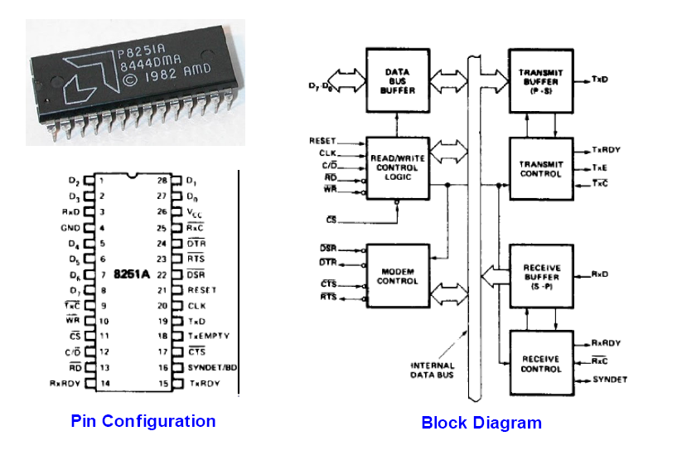
8251

Slide 17
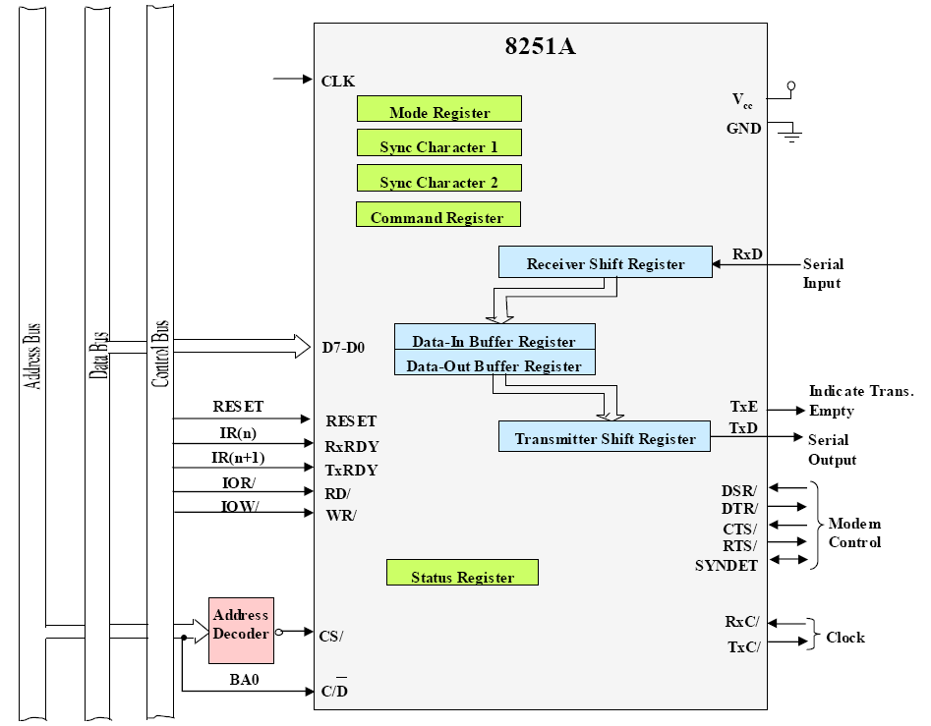
8251 Communication Interface

Slide 18
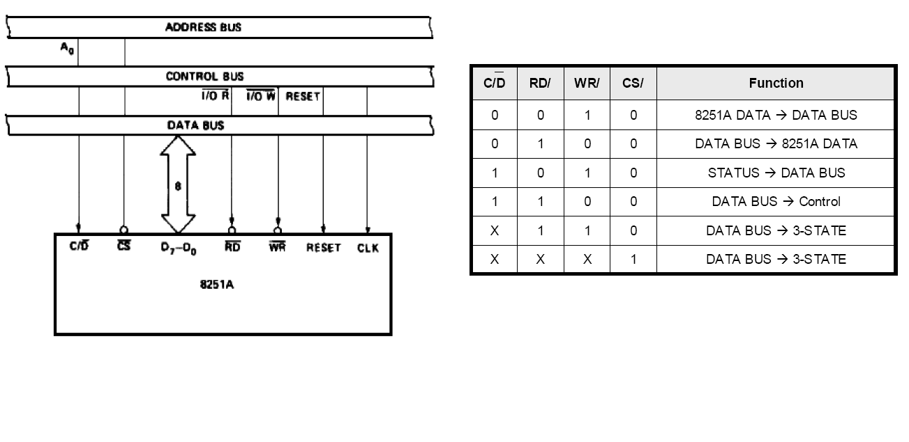
Interfacing to 8088

Slide 19
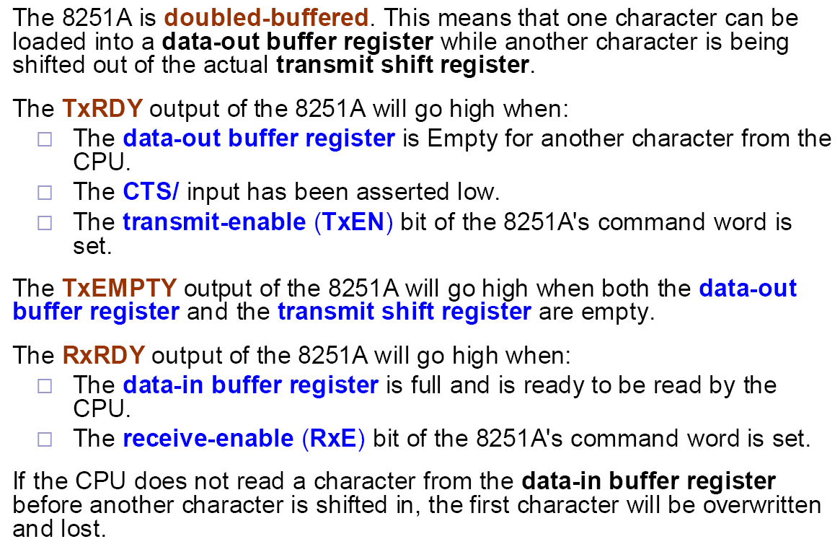
8251 Signals

Slide 20
Using 8251

Slide 21
8251 Mode Word
Asynchronous
Synchronous

Slide 22
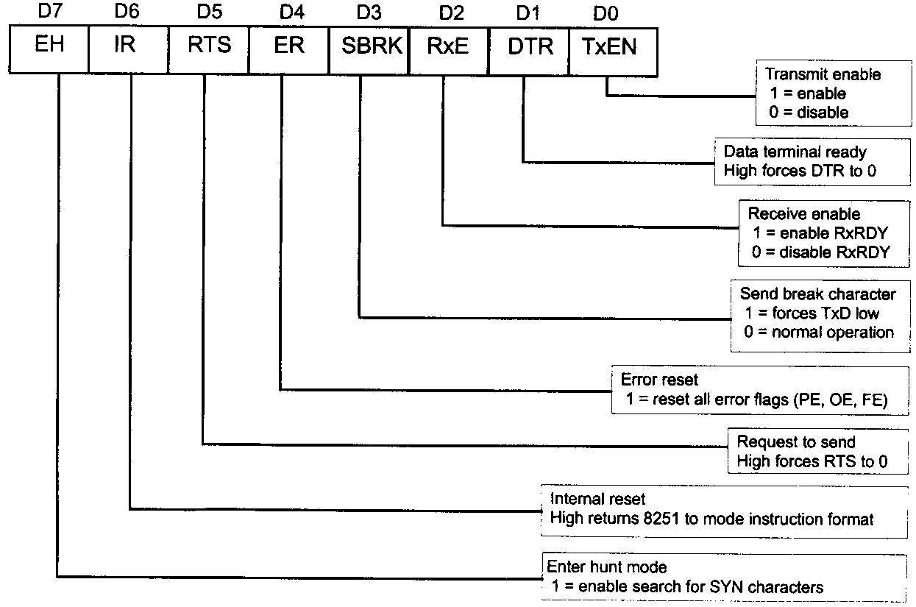
8251 Command Word

Slide 23
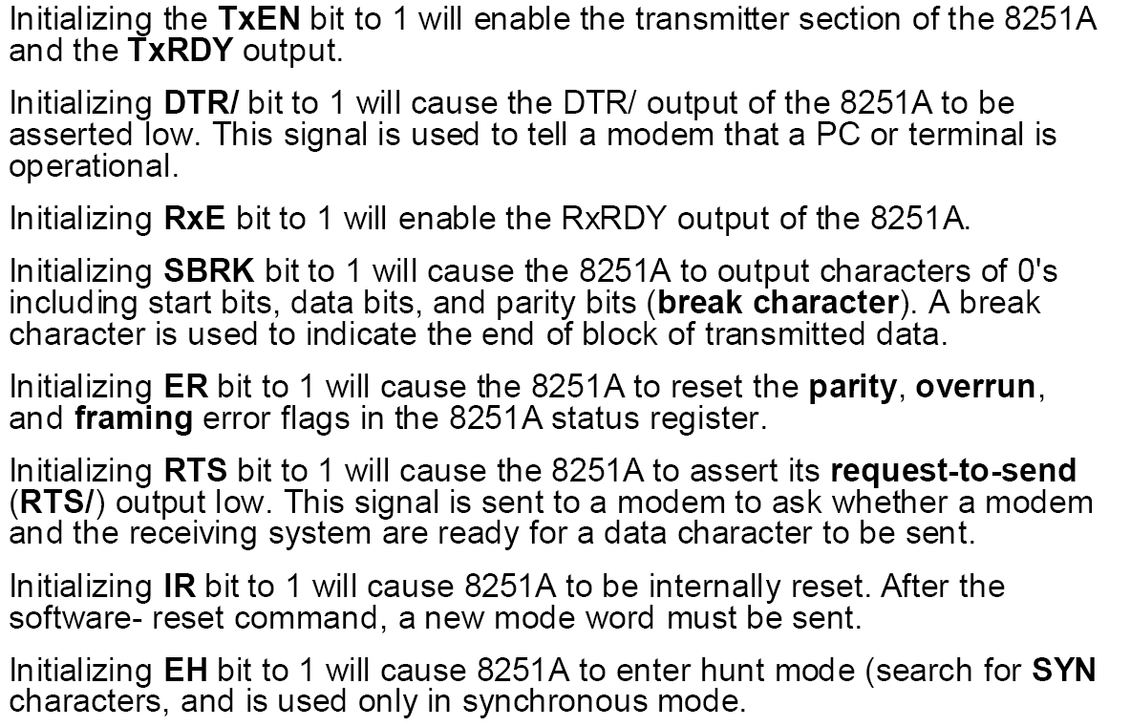
8251 Command Word

Slide 24
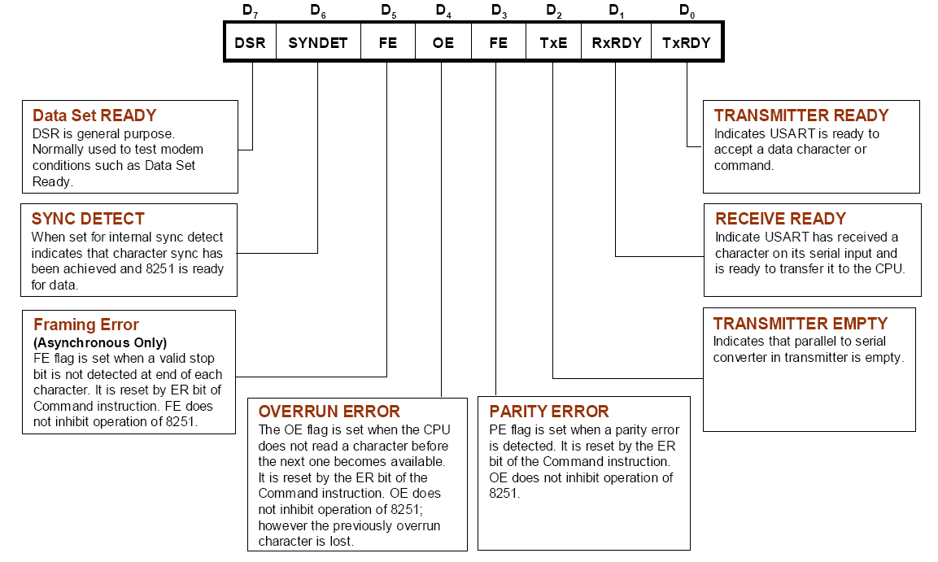
8251 Status Word

Slide 25
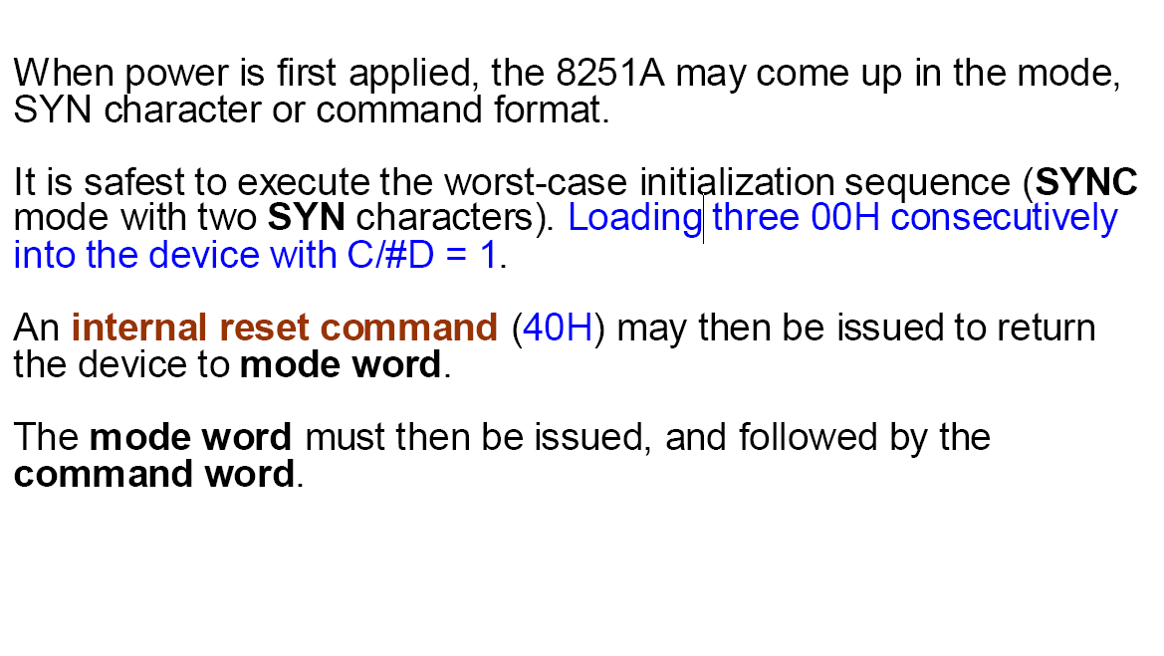
Initializing 8251

Slide 26
8251 Programming Example
Use 8251 to transfer 256 characters in asynchronous mode, assuming that the port addresses are 208H and 209H, the baud factor is 16, and 1 stop bit, 1 start bit, no parity bit, and 8-bit character are used.
Solution: Sender side: data is stored in Buf1
LEA DI, Buf1
MOV DX,209H
MOV AL,00H ;worse-case init.
OUT DX，AL
CALL DELAY
MOV AL,00H ;
OUT DX，AL
CALL DELAY
MOV AL,00H ;
OUT DX，AL
CALL DELAY
MOV AL,40H ;reset command
OUT DX，AL
MOV AL，01001110B ; mode word
MOV DX，AL
MOV AL，00110111B ; command word
OUT DX，AL
MOV CX，256 ; to send 256 char.
NEXT： MOV DX, 209H
IN AL，DX ; status word
AND AL，01H ; TxRDY?
JZ NEXT
MOV AL，[DI]
MOV DX，208H ; data register 208H
OUT DX，AL ; send the char.
INC DI
LOOP NEXT

Slide 27
8251 Programming Example
Receiver side: data will be stored in Buf2
Data segment
buf2 DB 256 dup(?)
Data ends
┆
MOV DX,209H
MOV AL,00H
OUT DX，AL
CALL DELAY
MOV AL,00H
OUT DX，AL
CALL DELAY
MOV AL,00H
OUT DX，AL
CALL DELAY
MOV AL,40H ; reset
OUT DX，AL
MOV AL，01001110B ; mode word
OUT DX，AL
MOV AL，00110111B ; command word
OUT DX，AL
MOV CX，256 ; to receive 256 char.
MOV SI，0
NEXT: MOV DX，209H
IN AL，DX ; status word
AND AL，02H ; RXRDY？
JZ NEXT
MOV DX，208H
IN AL，DX ; receive a char
MOV buf2[SI]，AL
INC SI
LOOP NEXT

